Slide 1
FraudDerm
Using Neo4j to Identifying Medicare Fraud
Case Study: Dermatology Specialty
Katya Aukamp, Song Gao, Akshay Sharathchandra, & Sonia Song
Datasci 205
Notes:
Akshay

Slide 2
Background/Motivation
Healthcare-related project
Original idea: mapping different genes that play a role in various cancers
Super complex
Algorithms were abstract
Pivoted to examining potential fraud in the healthcare industry
Notes:
Akshay

Slide 3

Why does this matter?
The National Health Care Anti-Fraud Association (NHCAA) conservatively estimate health care fraud amounts to about 3% of total health care costs
Other government and law enforcement agencies place the loss as high as 10% → $300 billion
Our goal: help fraud investigators identify where to put their time and resources more efficiently
Notes:
Akshay
Medicine is a personalized product but quickly and efficiently identifying outliers would help lesson the burden on fraud investigators

Slide 4
Data Organization
Centers for Medicare & Medicaid Services (CMS) → administrative claims at the doctor level
Only related to medicare
Doctors are identified by the National Provider Identifier (NPI)
Unique 10-digit identification number issued to health care providers by CMS
Payments made to physicians
Drug Prescriptions
Procedures
Data collected:
Reimbursement amount
Frequency of prescriptions
Procedure conducted
Notes:
Akshay
The data lists the payments made to physicians for drug prescriptions and procedures conducted
It shows the reimbursement amount and how many times the drug was prescribed and procedure conducted

Slide 5
Case Study Specifications
Due to the large volume of data available we wanted to show the proof of concept of how the system could be setup
The reasoning for this is Dermatology has a narrower range of procedure than other specialties with fewer internal complications, while also having a large sample size of available data, which is why we focused on Florida
Total Providers
Florida Providers
11,907
994
Procedures
Procedures
509
251
Drugs Prescribed
Drugs Prescribed
44
15
Notes:
Katya

Slide 6
Project Overview
Build the Relationships
What is common?
Who are Similar
Who are anomalies
We built relationships from each provider to the drugs and procedures prescribed and conducted
Weight: % of each drug/procedure as total medicare reimbursements
We calculated most common types of drugs prescribed and procedures conducted, as well as average and total amount paid, to understand what standard practices are
Using a Jaccard similarity algorithm we ranked how similar each provider is to one another. This was score and then used to make a second graph
We then use a PageRank algorithm to rank how similar the providers are, and how likely they are to be fraudulent
Notes:
Katya

Slide 7
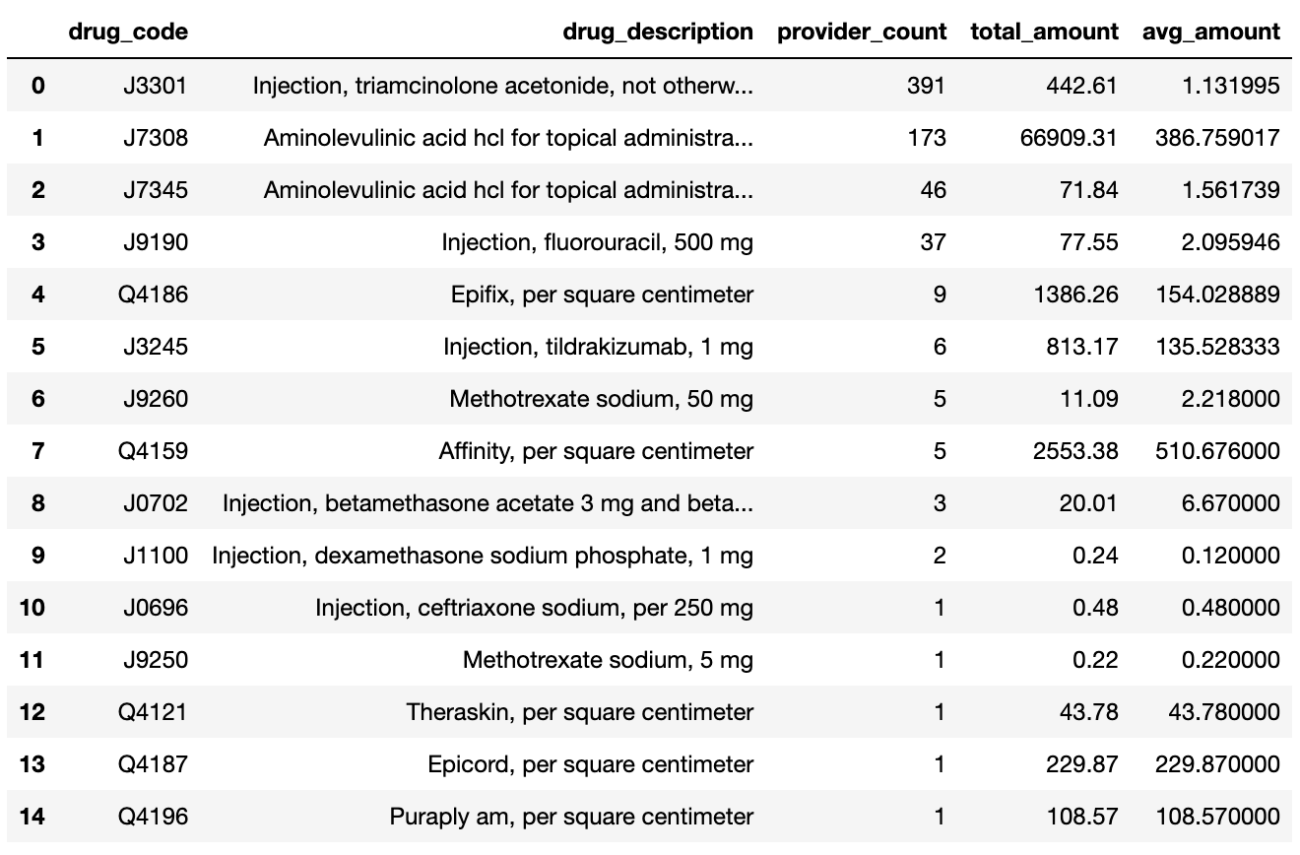
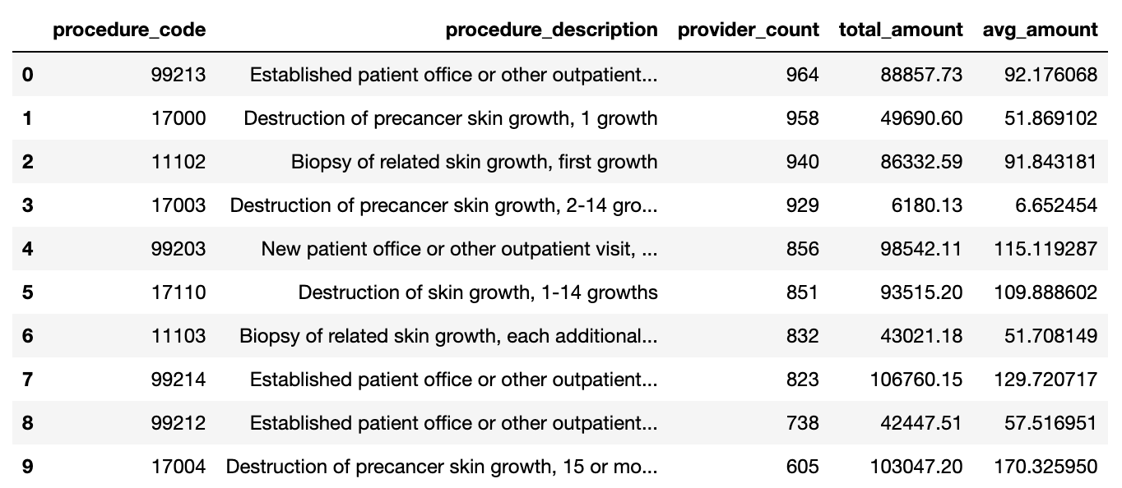
Common Practices
Identify what “norm” looks like
Provide benchmark against potential fraud cases detected by the graph algorithms
Most Commonly Prescribed Drugs
Most Commonly Conducted Procedures
Notes:
Sonia To understand what normal looks like,
Total and average
Most common procedures, what does normal look like?

Slide 8
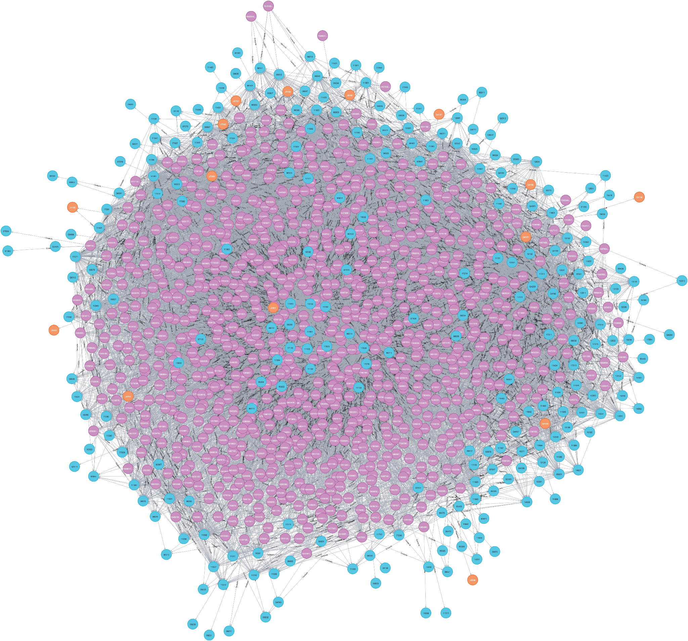
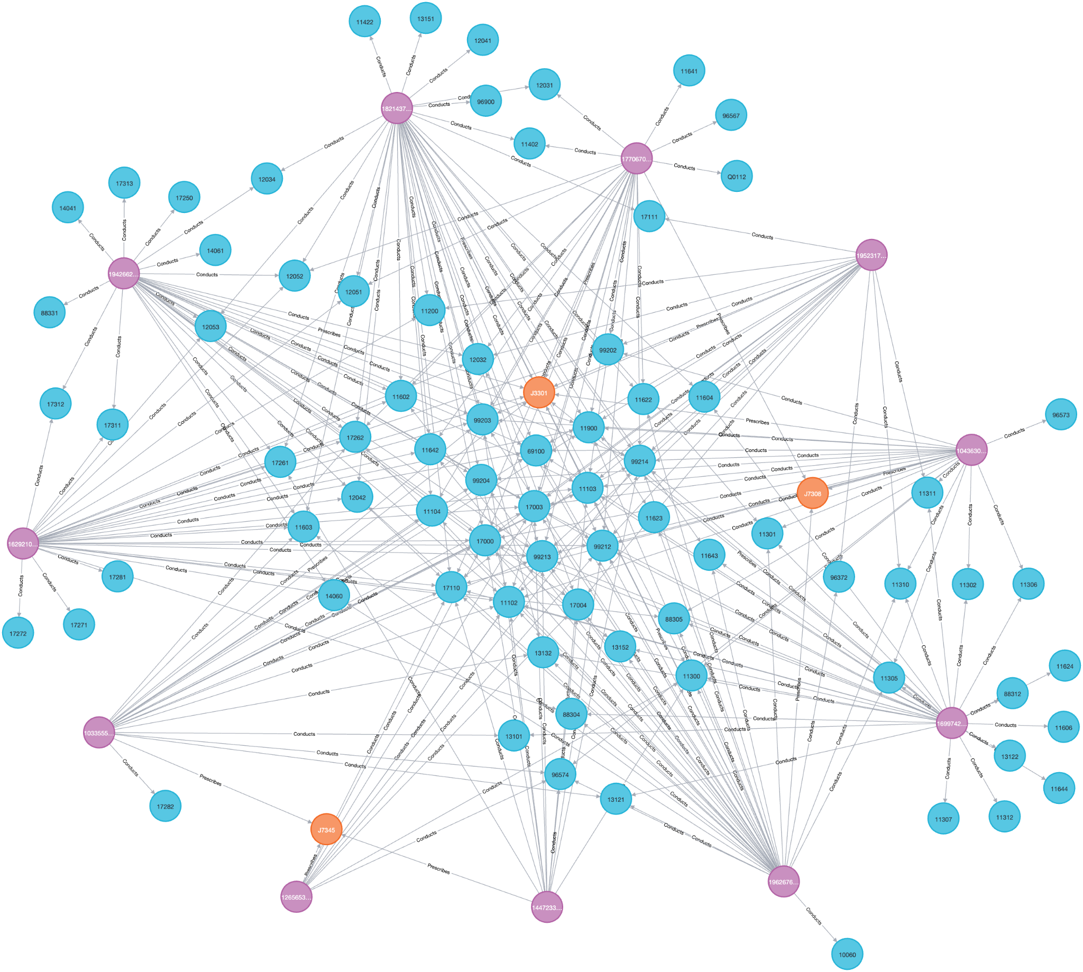
Provider Graph
No this is not a covid-virus
This shows the relationships between Providers and the procedures conducted and drugs prescribed
Procedures
Providers
Drugs Prescribed
Notes:
Sonia
This was our initial starting point
Middle graph: WY RHS: whole state of FL

Slide 9
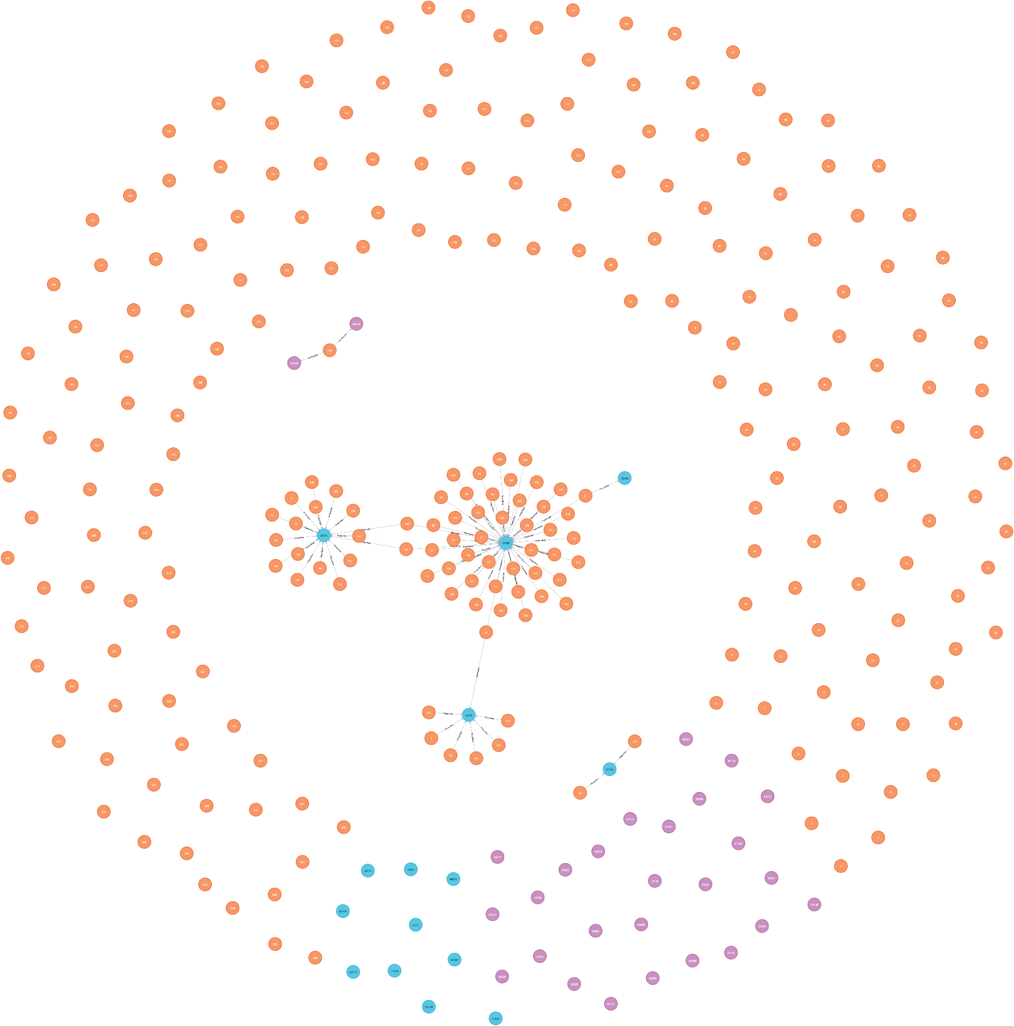
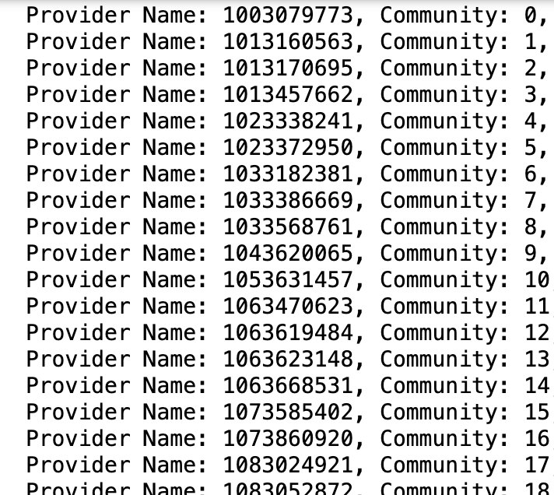
Algorithm
Community Detection Algorithm
Create provider communities
Detect potential collusion
Notes:
Sonia Most common drugs or procedures
LHS
RHS -

Slide 10
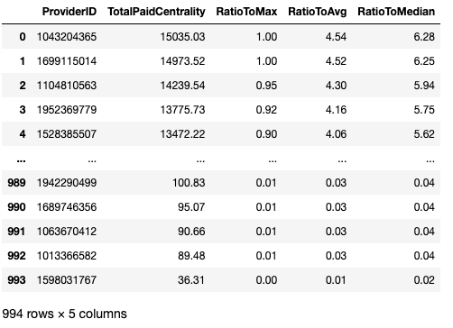
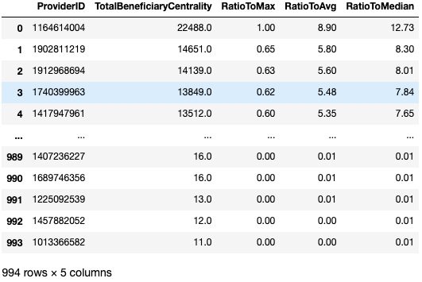
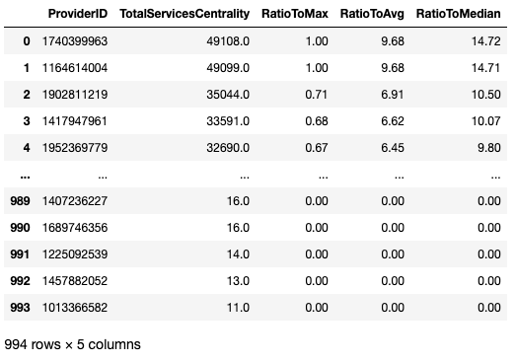
Weighted Degree Centrality
Weighted degree centrality is measuring the importance of nodes in a graph by looking at the relationships between them and how strong they are . We run it to identify doctors with abnormal total money paid, total patients and total services conducted.
Notes:
Song G We built centrality algorithms to calculate weighted degree centralities for total_amount_paid, toal_services and total_beneficiaries. We also calculate the ratios from degree centrality to the maximum, average and median values for each node. In this way we can capture outliers to be considered as high risk providers for further investigation. We captured a few outliers for property total_amount_paid, total_beneficiaries and total_services. The value of top outlier for total_amount_paid is 6X times than that of the median value, and the ratio is 12X and 14X for the value of top outliers for number of beneficiaries and number of services respectively.

Slide 11
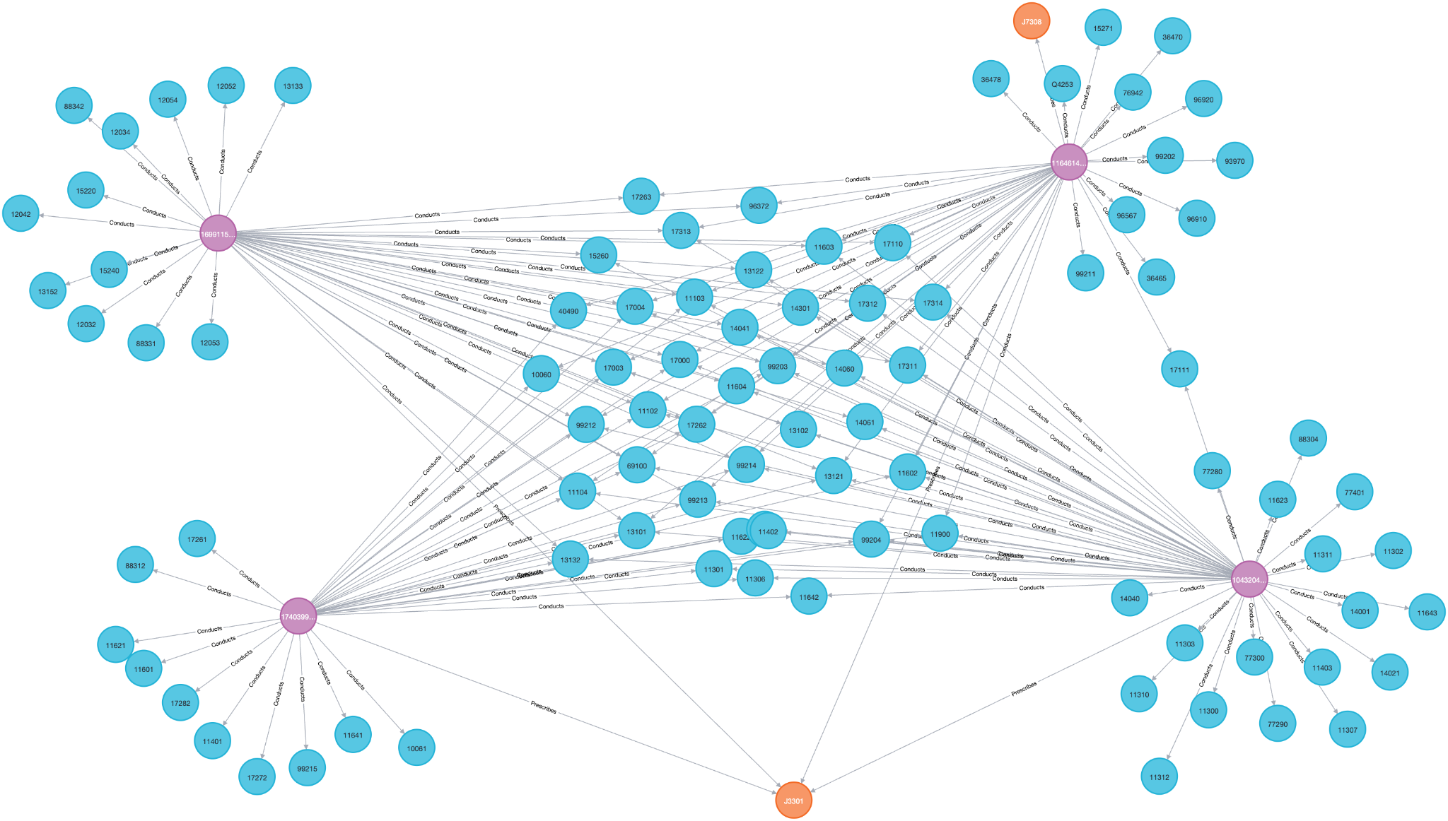
Weighted Degree Centrality
4 top outliers for further investigation in FL.
Notes:
Song G We picked 4 top outliers from the previous tables and draw a graph for them so we can see what procedures and drugs were conducted or prescribed by them. From this graph we can see that all of them conducted quite a few uncommon procedures which deserves a closer look. So we suggest those outliers for further investigation with high priorities.

Slide 12
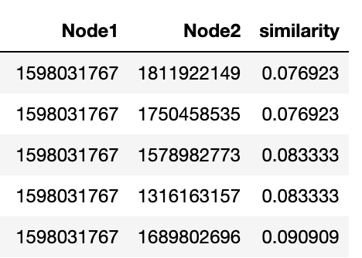
Weighted Jaccard Similarity
Running a Jaccard similarity compares each provider to one another
gds.nodeSimilarity.stream
The ranking was based on what percentage of total reimbursements came from which procedures/prescriptions
The more similar the procedure/prescription pattern the higher the similarity
What the results looks like
Low similarity areas
High similarity areas
9,940 total results
Notes:
Katya
The weighted jaccard similarity creates a similarity score between two key nodes. In this case we are comparing two providers and and seeing how similar is their prescription and procedure patterns. The weighting is based on how much total of total reimbursements per procedure or prescription. If for example provider X is receiving much more reimbursement from specific procedures there may be a question of why that procedure is being done so much more frequently. This algorithm creates vector pairs between the whole graph. In the above example it is only the Wyoming demo which is much smaller than the full Florida sample.

Slide 13
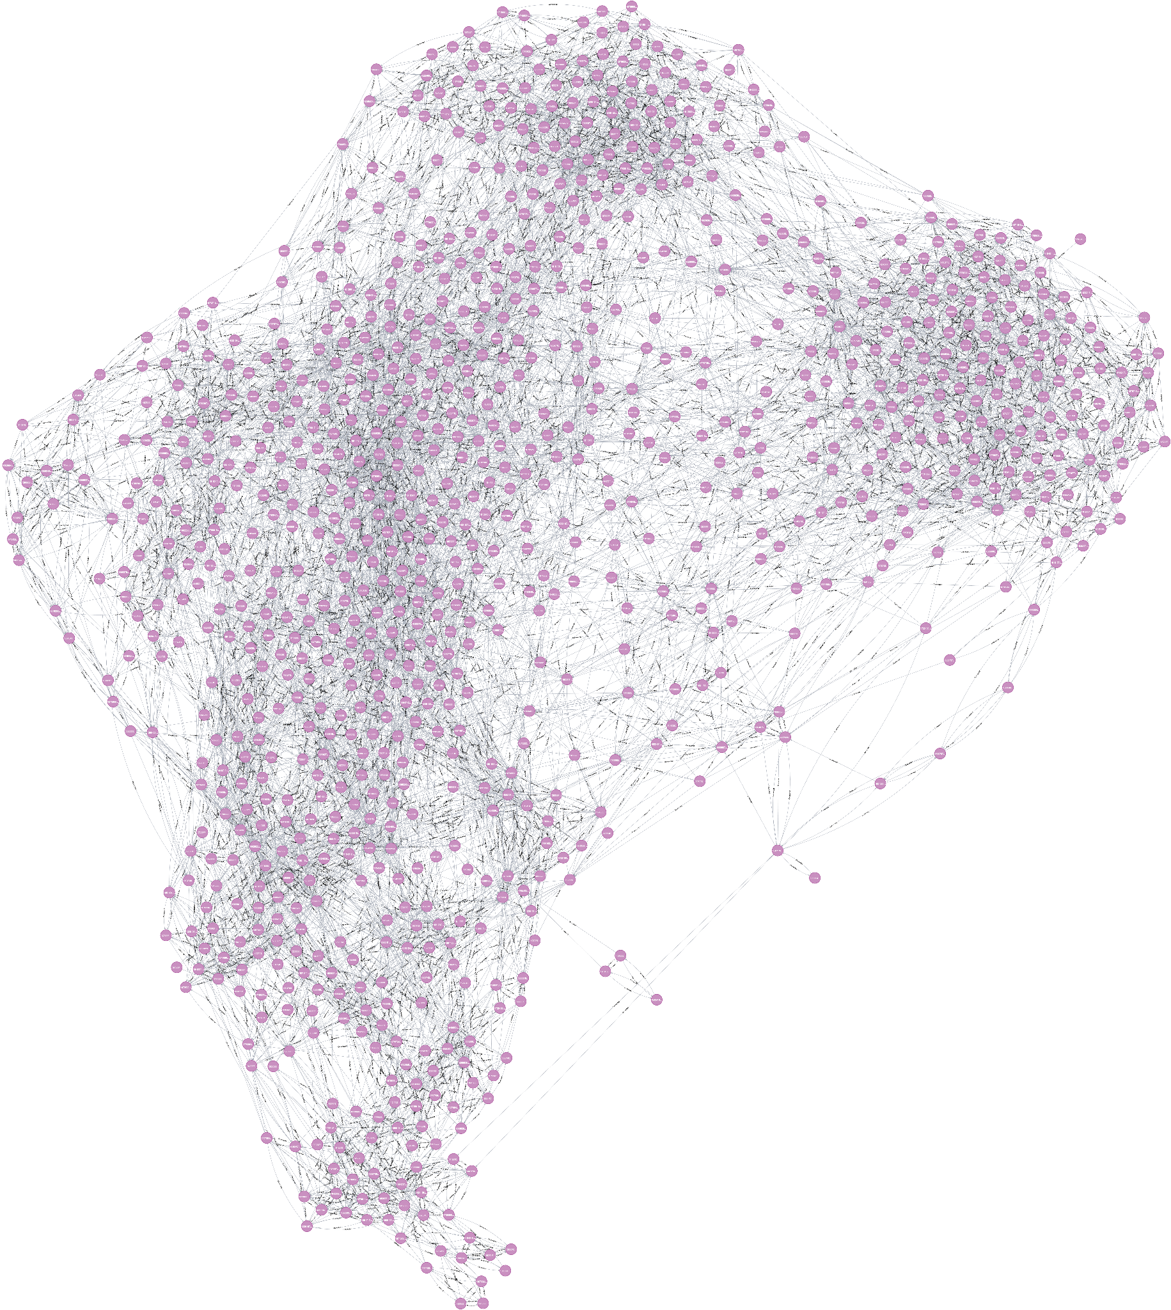
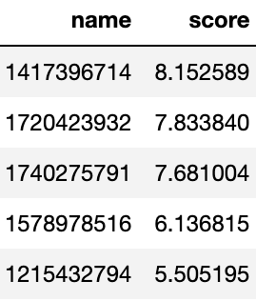
PageRank
We then the the similarity ranking of each doctor, and create an edge between doctors to create a ranked list of doctors based on their similarity and influence
Notes:
Katya
Taking the similarity score, we then created a second graph. This joins together all providers with the relationship being weighted by the similarity score. If we then run a PageRank on these relationships we get a rank of providers who are most to least influence or connected in their similarity. By providing a ranked list fraud investigators could more easily focus their attention. This would also be an effective way to validate findings and find room for improvement in this setup

Slide 14
Alternatives: MongoDB
MongoDB can be used to record information per physician (drugs administered, patient outcomes)
Flexible schema → capture data across healthcare systems
Aggregate and make reports for larger groups (hospital systems, cities, states)
A relational database won’t be particularly useful since the relevant data is captured at the physician level
Identify possible fraudulent actors → query results: how much money was received, what procedures were conducted
Notes:
Akshay

Slide 15
Alternatives: Redis
Redis could be used for real-time monitoring of prescriptions administered, or procedures done
Useful at the hospital administration level
Can be helpful for generating a shortlist of doctors who may be over prescribing
Redis can integrate with existing healthcare systems
A relational database may not be as useful here if the goal is real-time monitoring
Notes:
Akshay
Real-time alerts for drug prescriptions

Slide 16
References
Dataset:
https://www.youtube.com/watch?v=y__DC8Lo6TU&t=230s
https://www.ultipa.com/document/ultipa-graph-analytics-algorithms/jaccard-similarity/v5.0#:~:text=Jaccard%20similarity%2C%20or%20Jaccard%20index,their%20neighborhood%20sets%20are%20similar
Notes:
Akshay

